Slide 1
GROUND WATER QUALITY IN INDIA
An Analysis of the Primary Factors contributing to Ground Water Pollution in India
GROUP DETAILS
Shoumik Goswami
Vanessa D’ Souza
Vyshak Reghukumar

Slide 2
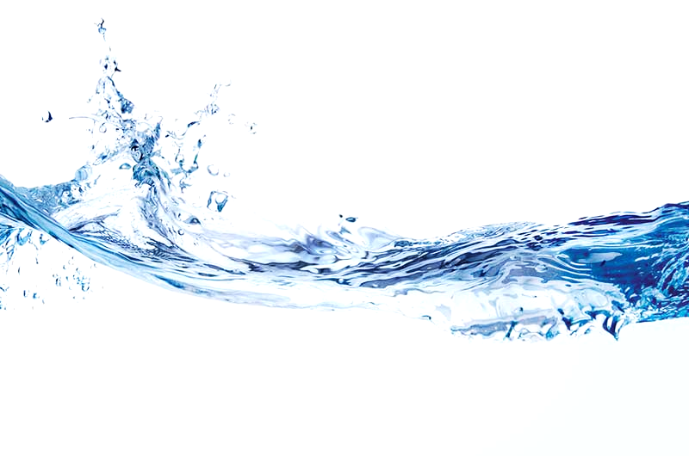
AGENDA
Introduction
Problem Statement
Data
Research
Methodology
Technical Result
State wise Analysis
Conclusion
Future Scope

Slide 3
Introduction

Slide 4
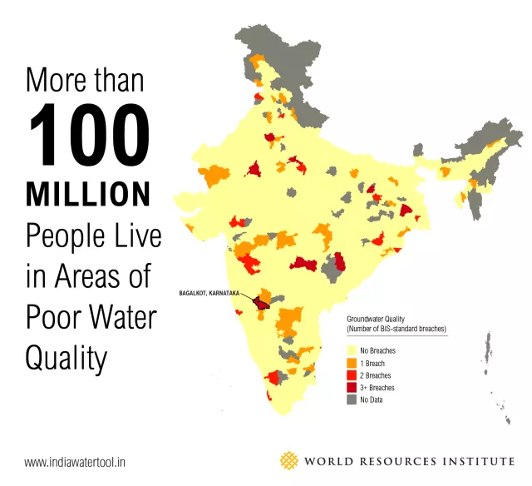
Introduction
Ground Water pollution is a major environmental issue in India. Groundwater pollution (also called groundwater contamination) occurs when pollutants are released to the ground and make their way down into groundwater.
Common Pollutants:
Human Waste
Salt
Hazardous Waste
Pesticides
Common Sources:
Residential neighborhoods
Agricultural sites
Construction sites
Factories
http://www.wri.org/blog/2015/02/3-maps-explain-india%E2%80%99s-growing-water-risks
Notes:
http://all-about-water-filters.com/groundwater-pollution-vs-surface-water-pollution/ details

Slide 5
The Problem Statement

Slide 6
THE PROBLEM STATEMENT
Analyse areas in India having water degradation issues over the years.
Explore
Repetitive patterns of water quality degradation in the same area for multiple years.
Analyse
Factors that are leading to the lower water quality.
Forecast
Possible water quality degradation over time based on the current data

Slide 7
The Data

Slide 8

DATA
The dataset was released by National Data Sharing and Accessibility Policy (NDSAP). Data Source: https://data.gov.in/catalog/water-quality-india-2014 The combined dataset contains the following:
Number of locations: 447
Number of Variables to determine water quality: 6
Number of states covered in the dataset: 22
SNo. | Variable | Definition | Acceptable values
1 | Temperature | Temperature of the groundwater | ~25
2 | pH | pH level of the groundwater (indicates acidity) | 6.5 - 8.5
3 | Conductivity | Ability of groundwater to conduct current | 150- 500
4 | B.O.D. (Biochemical Oxygen Demand) | Amount of dissolved oxygen in the groundwater | 4-11
5 | Nitrate (N+) Nitrite (N) | N+ and N levels | <10
6 | Fecal Coliform | Level of fecal contamination | < 0.1

Slide 9
Research

Slide 10
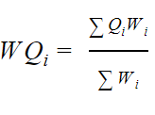

WQI
Water Quality Index (WQI) is a very useful and efficient method which can provide a simple indicator of water quality and it is based on some very important parameters.
In current study, Water Quality Index (WQI) was calculated by using the Weighted Arithmetic Index method. In this model, different water quality components are multiplied by a weighting factor and are then aggregated using simple arithmetic mean.
Where,
W_{i} = Relative (unit) weight for nth parameter
S_{i} = Standard permissible value for nth parameter
I = Proportionality constant.
Where,
Q_{i} = Quality rating
W_{i} = Relative weight in general

Slide 11
Parameters and WQI Range
Parameters | Si | Wi | Acceptable range
pH | 8.5 | 0.11 | 6.5-8.5
Conductivity | 250 | 0.004 | 150 to 500
Temperature | 25 | 0.1 | ~25
BOD | 6 | 0.11 | 4-11
Nitrate | 200 | 0.1 | < 10
Fecal Coliform | 20 | 0.16 | <0.1
S. No | WQI value | Water quality
1 | <50 | Excellent
2 | 50-100 | Good
3 | 100-250 | Poor
4 | 250-350 | Very poor
5 | >350 | Water unsuitable for drinking

Slide 12
Methodology

Slide 13
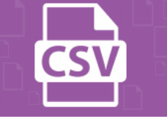




METHODOLOGY
1
2
3
4
COLLECT AND CLEAN DATA
STATE WISE REPORTS
CALCULATE WQI VISUALISE AND ANALYSE
CREATE TIME SERIES MODELS AND FORECAST
PARAMETERS
Extract data from Data.gov.in
Merge and Transform data
Analyse parameters across the years
Predict values using Holt’s Winter Time Series model
Model state-template (statewise.Rmd)
Create multiple state reports (config.R)
Calculate WQI
Visualise various parameters across years through geoplots

Slide 14
Result

Slide 15
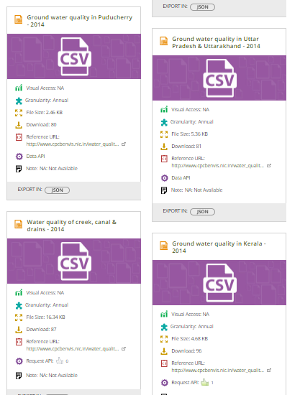
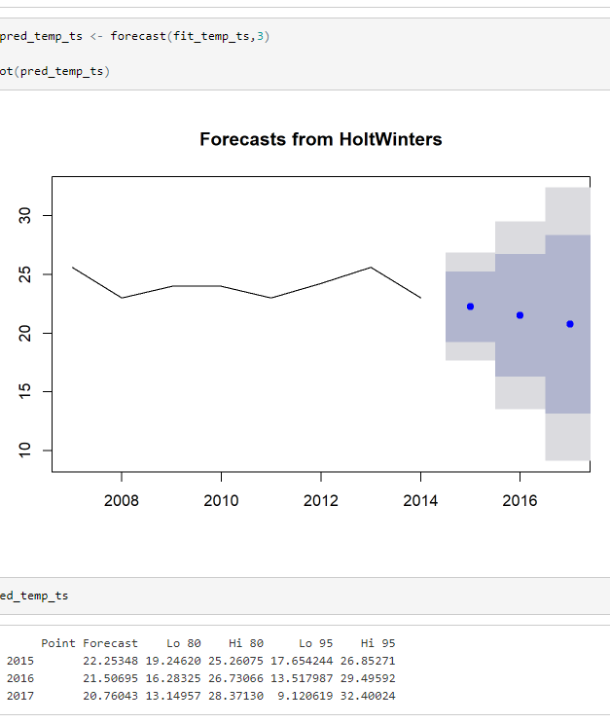
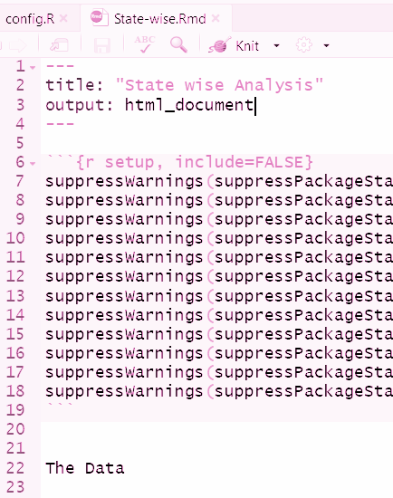
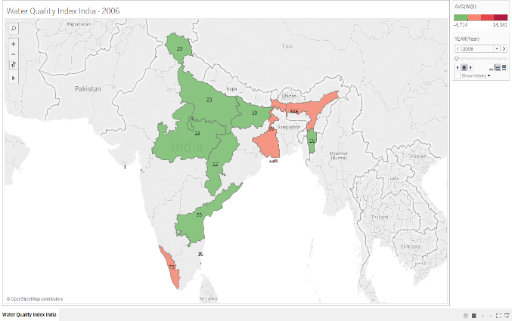
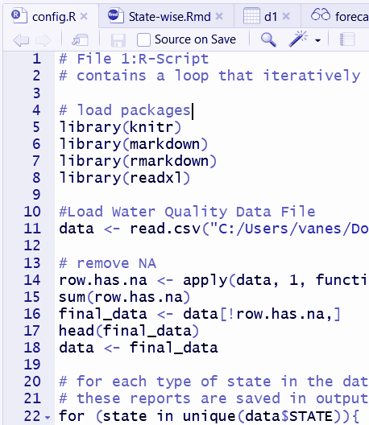
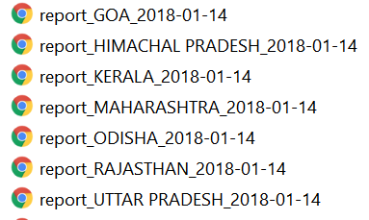
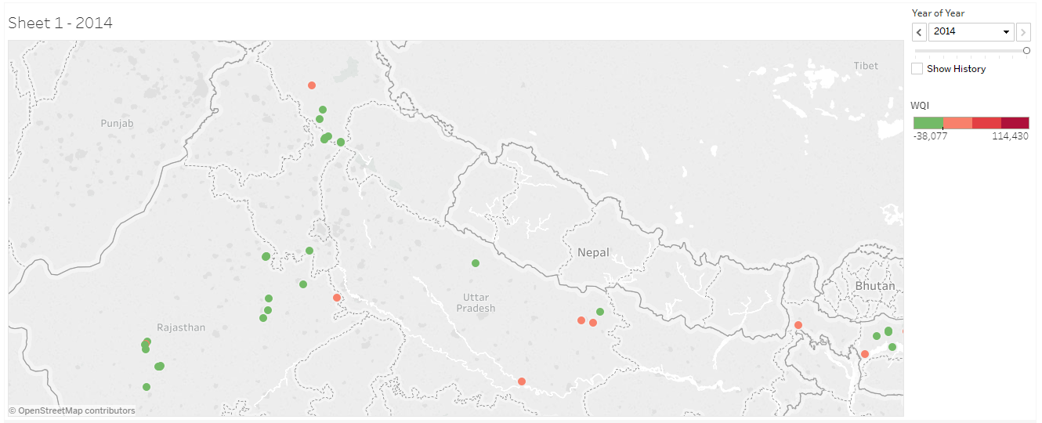
RESULT
REAL LIFE GOVERNMENT DATA
TIME SERIES MODELLING
STATE WISE REPORTS AT A CLICK
INDIA WIDE GEOPLOTS

Slide 16
State Wise Analysis

Slide 17
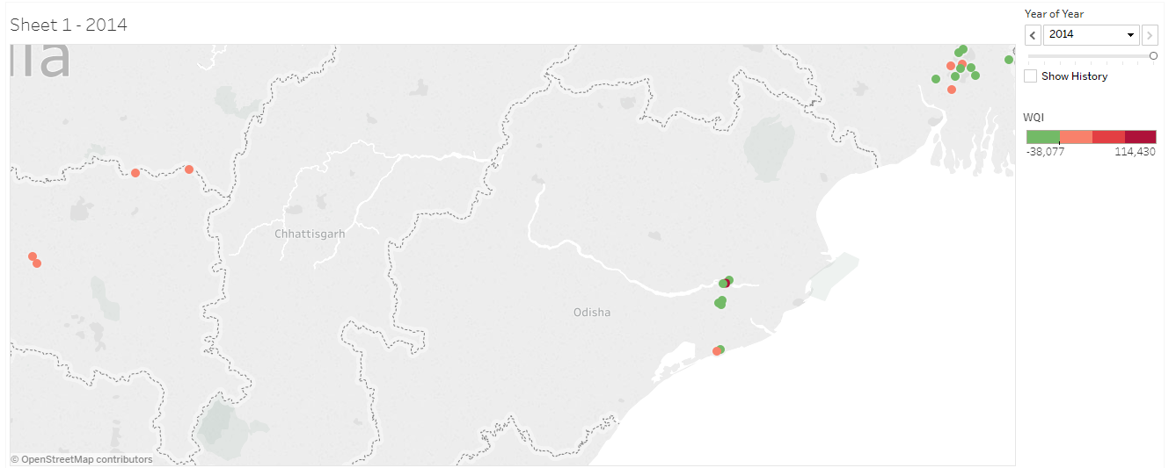
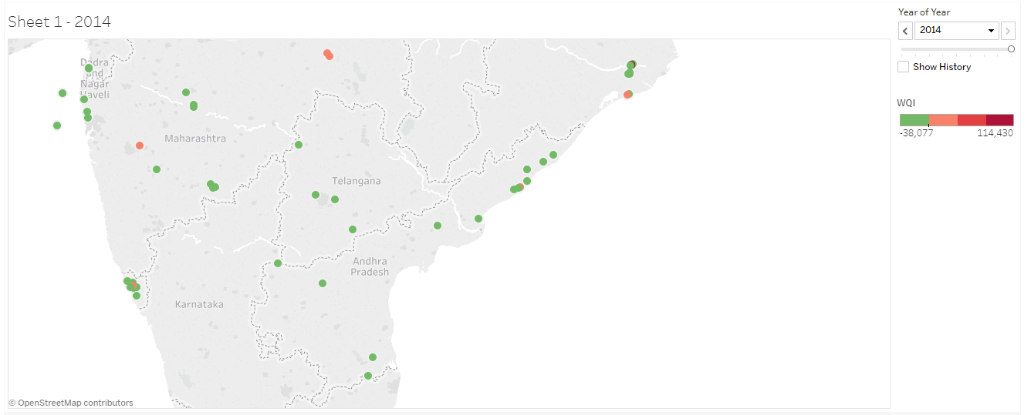
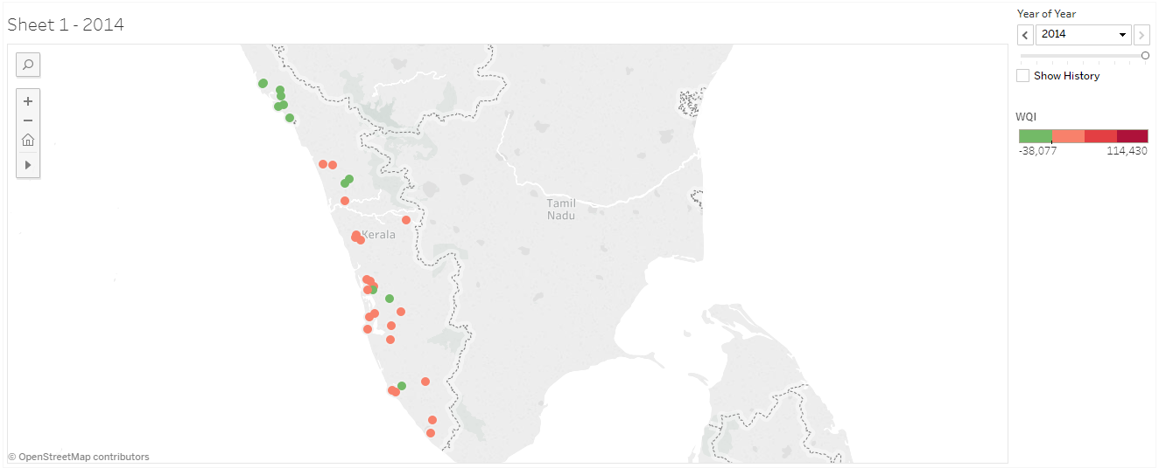
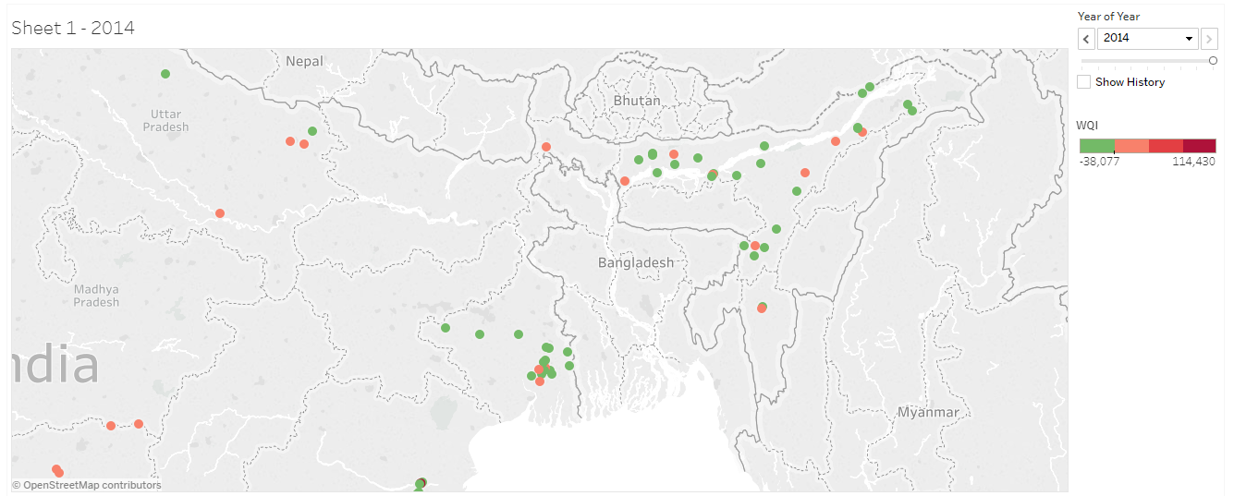
State Wise Analysis
The locations (latitude and longitude) of every bore-well was generated using R and the WQI values calculated.
As of 2014, we can see the condition of these locations.
We can deep dive into every location and understand the parameters in depth which is causing the ground water quality to deteriorate.

Slide 18
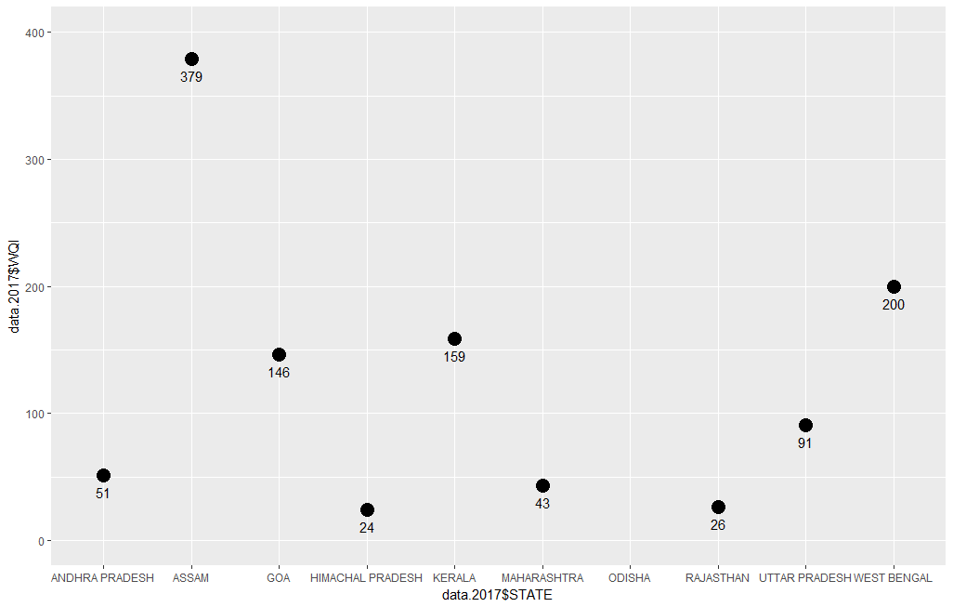
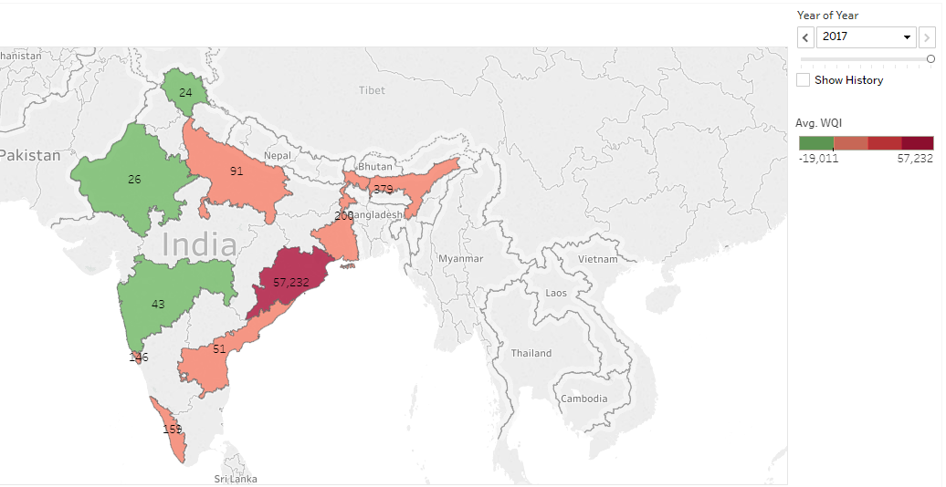
Current scenario
The forecasted WQI values for 2017 reveals the following states which have very poor ground water quality.
Ground water contaminated by iron has been reported from Assam, West Bengal, Orissa, Chhattisgarh, and Karnataka.
(Source: http://cgwb.gov.in/WQ/GROUND%20WATER%20QUALITY%20SCENARIO%20IN%20INDIA.pdf)

Slide 19
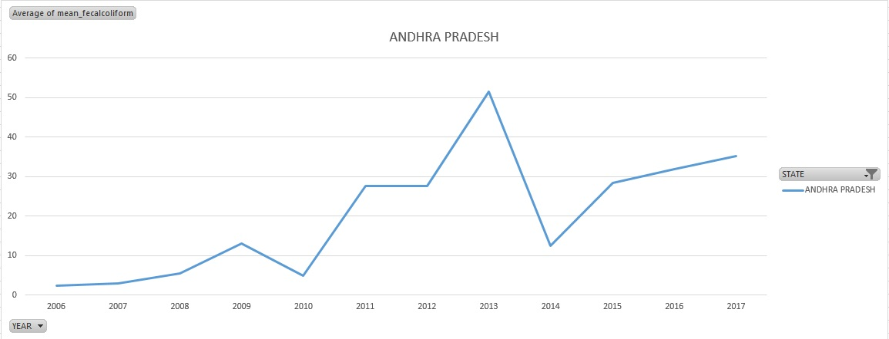
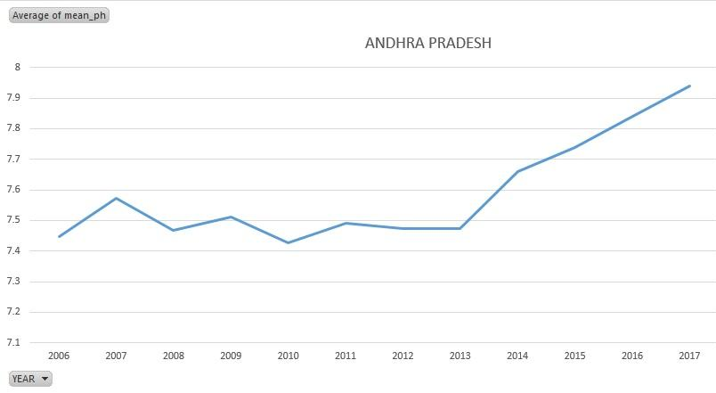
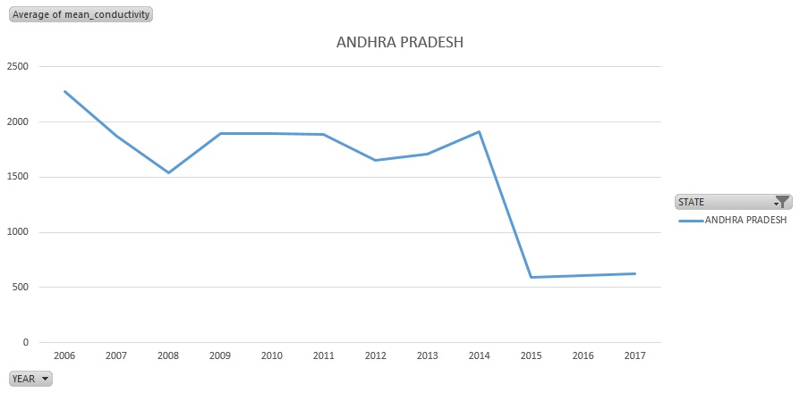
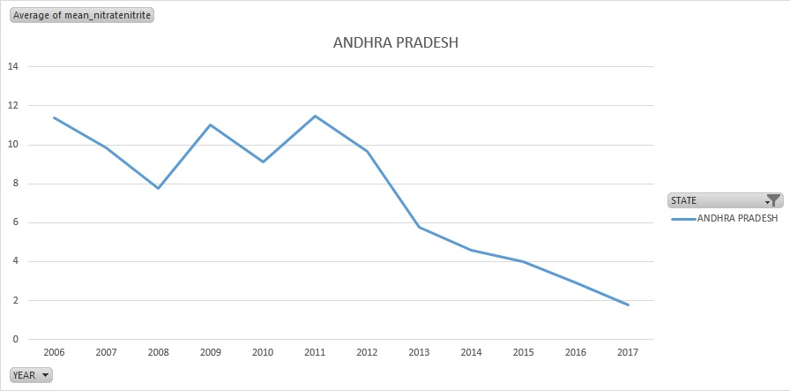
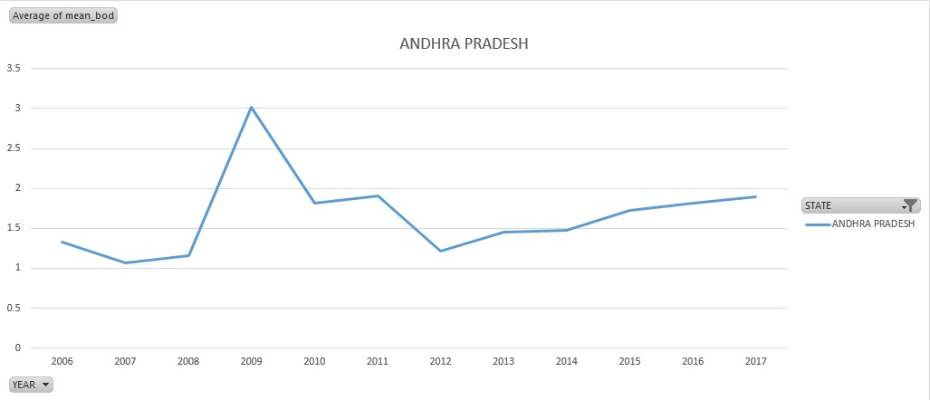
State wise analysis
Andhra Pradesh had excellent WQI (2014 – 32); but it is steadily increasing implying that groundwater in Andhra is getting polluted.
pH is has been on the higher side and shows increasing trend, implying alkalinity.
Conductivity falling down, implying that salinity is decreasing.
BOD is also showing steady growth, implying that it contains potentially harmful bacteria or bacteria producing undesirable physical characteristics such as taste or odor.
Nitrate and Nitrite levels also found to be high, though they are generally reducing.
Fecal coliform is also showing growing trends, indicating contamination by human sewage or animal droppings.

Slide 20
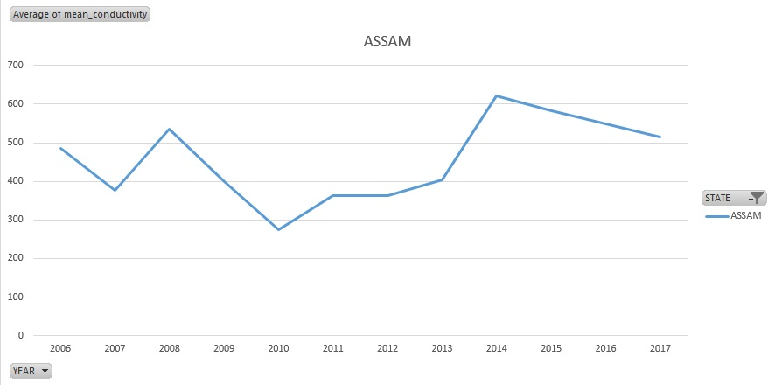
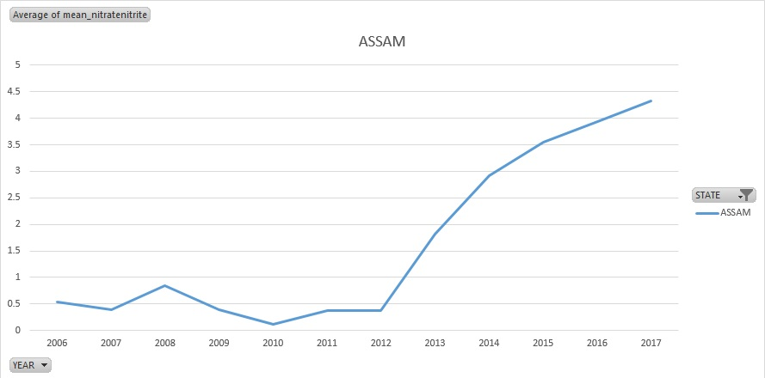
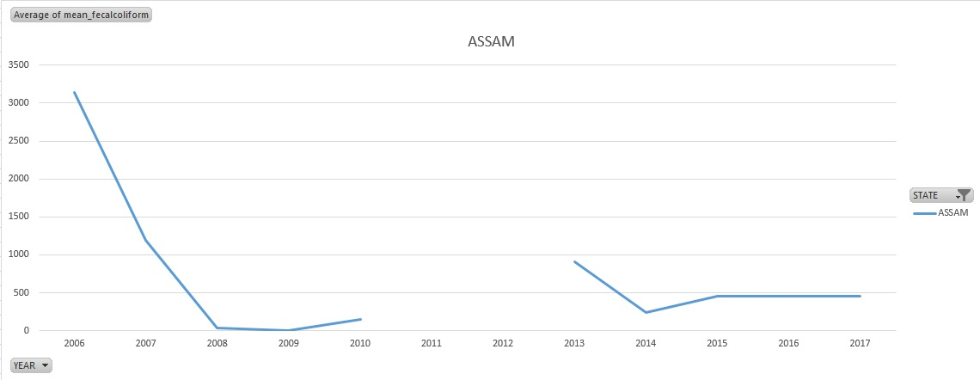
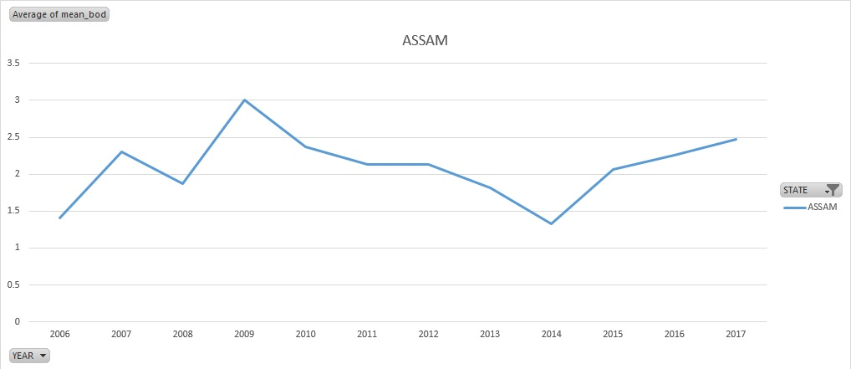
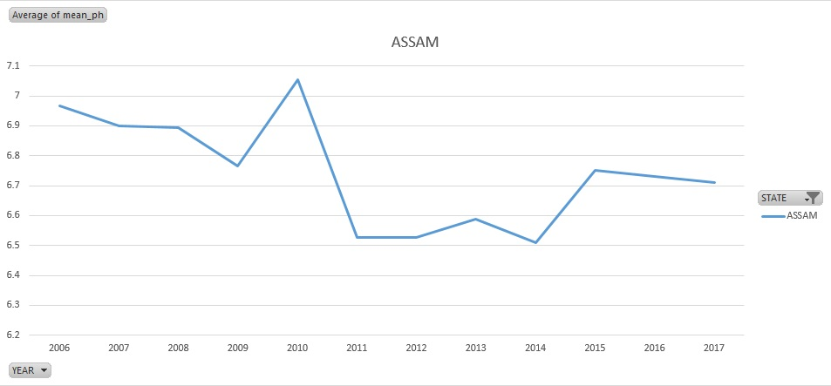
State wise analysis
Assam had alarmingly high WQI in 2006 and 2007, though they've drastically improved in 2008 (possibly due to availability of more data). However, there is still risk of increase in WQI in upcoming years.
pH level is in acceptable levels, though recent years indicate possibility of acidity.
Conductivity has been increasing in recent years, implying increasing salinity.
BOD shows irregular trends, though they have been on the lower side in recent years.
Nitrate and Nitrite levels increasing explosively, which is a matter of concern.
Fecal coliform has shown tremendous improvement, though it is steadily rising which is a matter of concern.

Slide 21
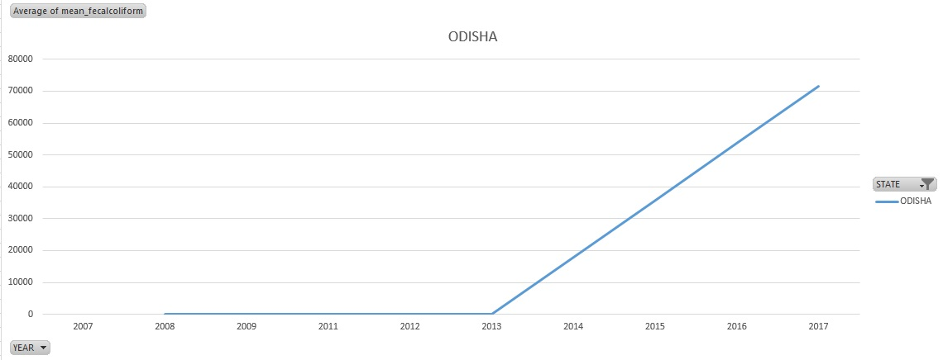
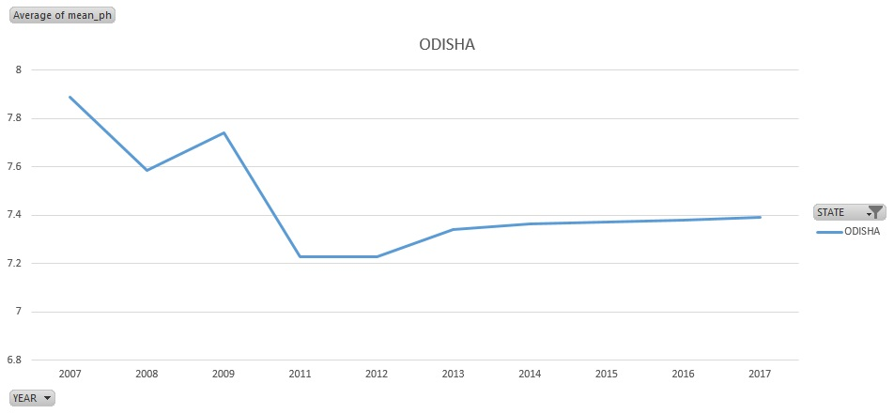
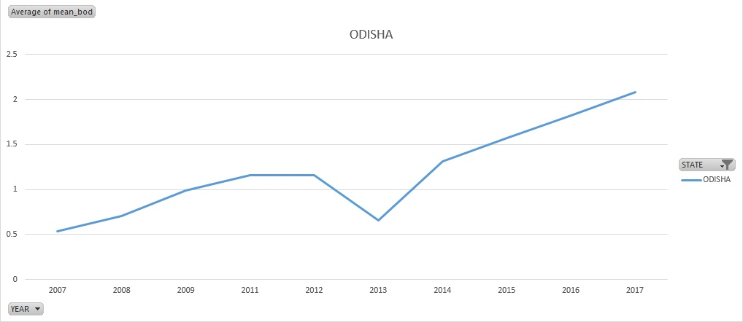
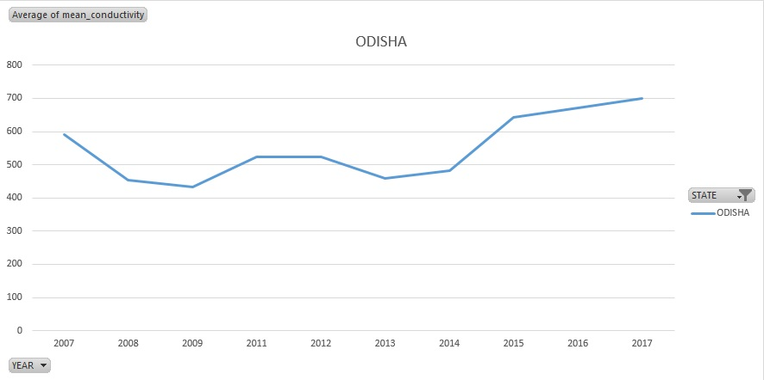
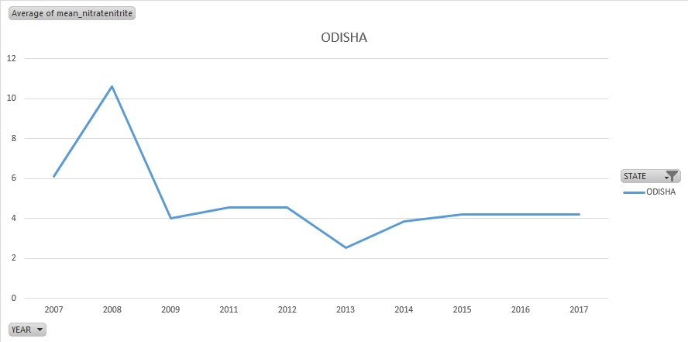
State wise analysis
Odisha has generally shown excellent WQI; however it displayed a dangerously high WQI for 2014 (possibly due to erroneous data). The WQI values for the forecasted periods are way above the safe limit of 50, due to this possible anomaly.
pH, BOD are in acceptable levels.
Conductivity has been steadily increasing.
Nitrate and nitrite levels have been steadily decreasing, implying improved water quality.
Fecal coliform showed a humongous spike in 2014, explaining the abrupt behaviour of WQI. This outlier could possibly be erroneous data.

Slide 22
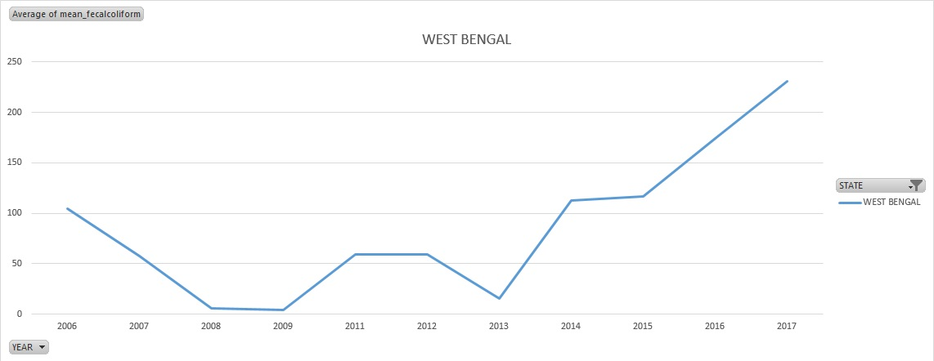
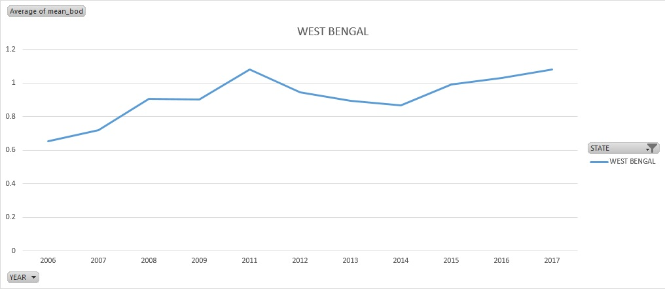
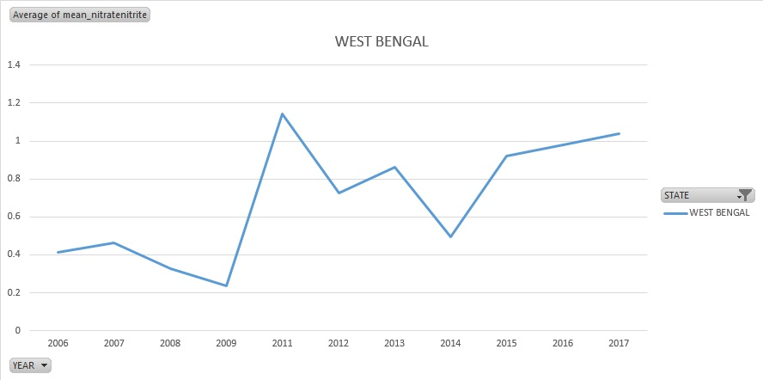
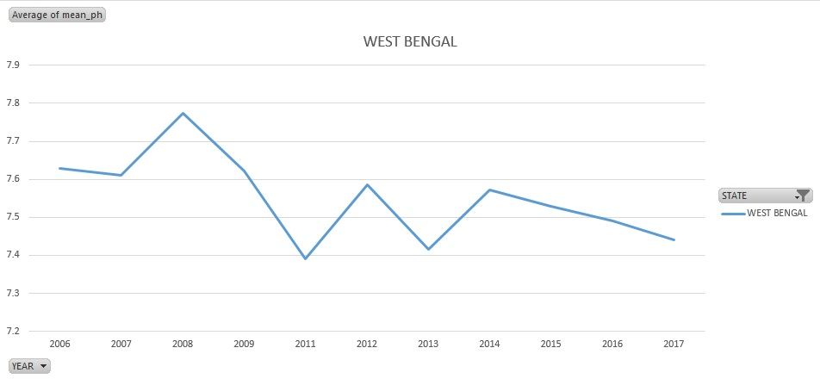
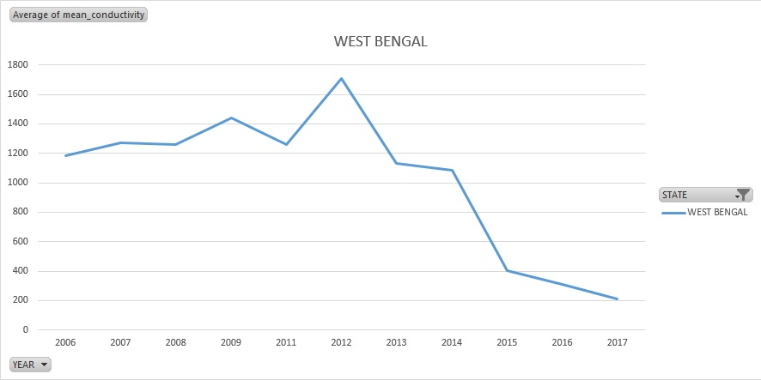
State wise analysis
WQI in West Bengal has been steadily increasing, implying poor quality. Predictions also show further deterioration in quality.
pH is generally in acceptable levels, though it is quickly moving towards alkalinity.
Conductivity is falling down, implying decreased salinity.
BOD and Nitrate and Nitrite levels are at acceptable levels, though they show growing trends.
Fecal coliform shows high rate of growth, implying contamination in the future.

Slide 23
Conclusion

Slide 24
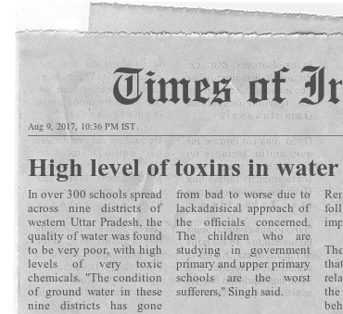
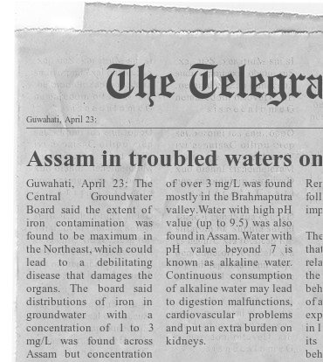
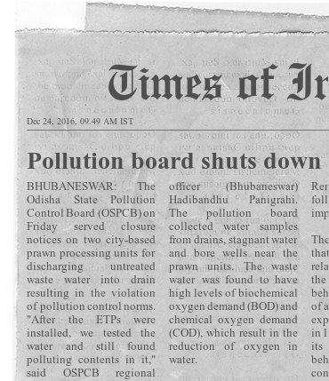
CONCLUSION
From the above analysis, it can be concluded that most states are facing issues of alkalinity, salinity and possible bacterial contamination.
Therefore it is highly critical to take into consideration the remedial measures for the same, else groundwater could get polluted to a great extent in these states.

Slide 25
Further Scope

Slide 26
Further Scope
Improve forecasts
Monitor Reforms and its Impact
Regression modelling
Collect more data and use better time series models like ARIMA and ANN to get more accurate forecasts.
Collect, validate and monitor water quality data validate impact of government reforms on WQI
Collect more parameter data and develop a regression model to understand the relation between these parameter
Study other states
Lakes, Ponds and rivers
API Exports
Study the states with limited data and understand the water quality index for the same
Extend the models to lakes, ponds and rivers data to understand the water quality and suggest preventive measures
If Water quality data becomes available through API - Automated Reports and Dashboards can be created and scheduled

Slide 27
Thank You

